Slide 1
UN-SUPERVISED LEARNING
CLUSTERING

Slide 2
Problem -Statement
GIVEN –DESIGN MATRIX
SOLVE
RATINGS BASIS TRAVELLERS FROM EAST ASIA
# POSSIBLE CLUSTERs
SUMMARIZE BEHAVIOURS
CLUSTER JUSTIFICATION AND VALIDATION
ACCURACY AND MODEL SELECTION
UN SUPERVISED CLUSTER PROBLEM

Slide 3
THE DATA SET
Total Variables : 10
Art_galleries Object
Dance_clubs Object
Juice_bars Object
Restaurants Object
Museums Object
Resorts Object
Parks/Picn Object
Beaches Object
Theatres Object
Rel_inst Object
IVs : 10
DV :NA

Slide 4
APPROACH
Pre-Modelling
Modelling
Post –Modelling

Slide 5
THE JOURNEY..1
Pre –modelling
MODELLING
Load / Eyeball the data set
Clean the data set
EDA
Data Transformation
Hierarchical
KMeans

Slide 6
THE JOURNEY..2
POST MODELLING
MODEL SELECTION STRATEGY
Evaluation metrics
Silhouette Score
Basis Expert feedback on possible clusters -Labels

Slide 7
Pre -modelling..DATA CLEANING
INITIAL DATASET
CLEANED DATASET
TOTAL FEATURES : 11
TOTAL OBSERVATIONS : (980)
TOTAL FEATURES : 10
TOTAL OBSERVATION (980)
Customer ID columns is dropped
No Null Values in the dataset
Data-set converted to Numeric from Object

Slide 8
Pre modelling -EDA
Univariate
Bivariate
Understanding the data structure
Skews/Outliers
Data Insights

Slide 9
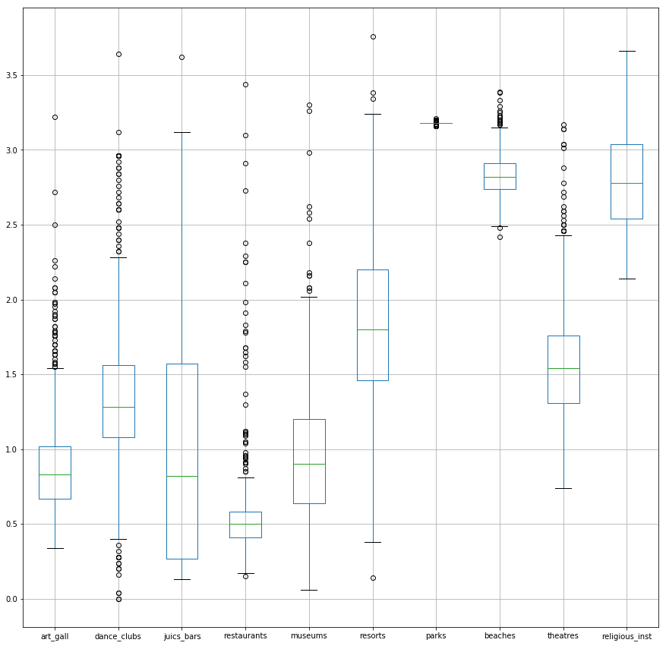
DATA SET CHARACTERISTICS
Parks /Rel_Inst /Beaches amongst the highest rated
Restaurants /Art_gall/Museums amongst the lowest rated
Dance _clubs ratings are highly polarised
Juice_bars’s ratings have the widest range

Slide 10
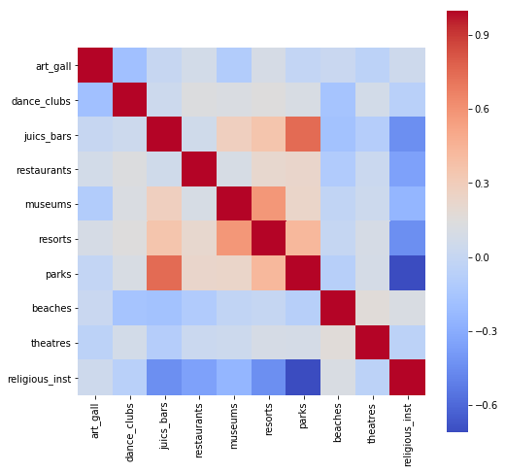
Bivariate –Correlations
Avg_ratings on Parks are
negatively correlated with Juice_bars
Positively correlated with Rel_inst
Ratings on Rel_inst are
Positively correlated with Resorts/Juice_bars/Restaurants

Slide 11
Key CONCLUSION
POLARIZED RATINGS CANNOT BE CONSIDERED AS OUTLIERS
THEREFORE ….> DATA TRANSFORMATION

Slide 12
DATA TRANSFORMATION –In sum
Original
X
Scaled
Rescale_X
Normalized
Norm_X
PCA(0.90)
PCA_X
4 SETS OF DESIGN MATRIX [X] KEPT READY AND WILL BE PLACED BEFORE THE ALOGS TO CHECK THE ACCURACY OF PREDICTION

Slide 13
MACHINE LEARNING MODELS
Hierarchial Model
KMeans
Given the data set has non categorical features

Slide 14
HierarchIal MODEL
HIERARCHIAL
SCIPY LIBRARY
SKLEARN
LIBRARY

Slide 15
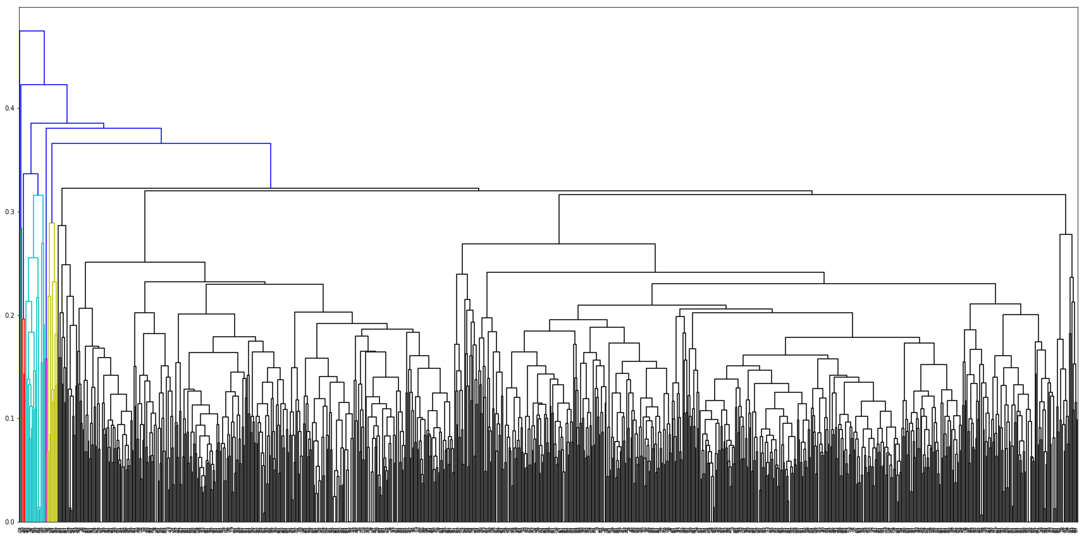
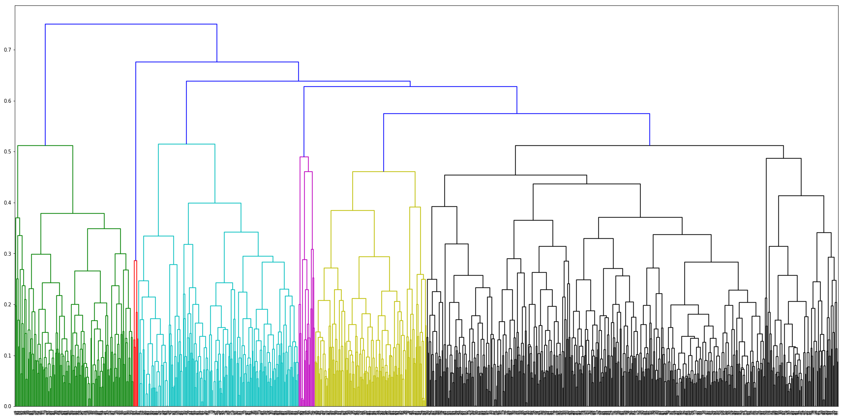
HierarchIal MODEL ..SCIPY LIBRARY
Euclidean+AVERAGE +NORM_X
Euclidean+COMPLETE+Norm_X

Slide 16
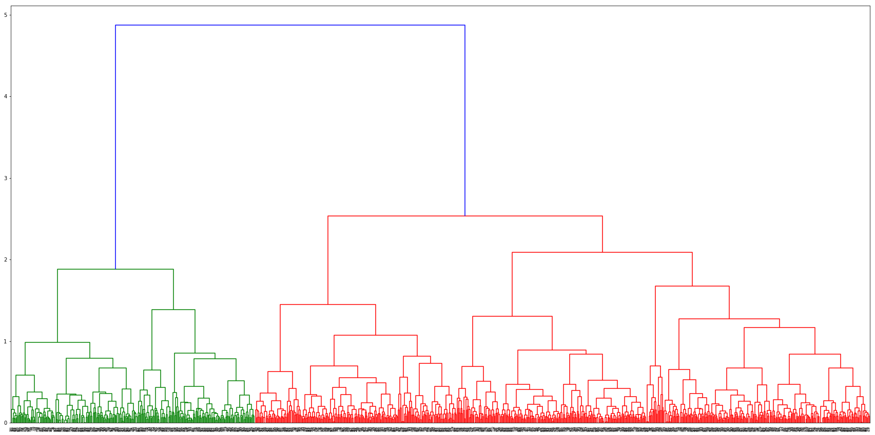
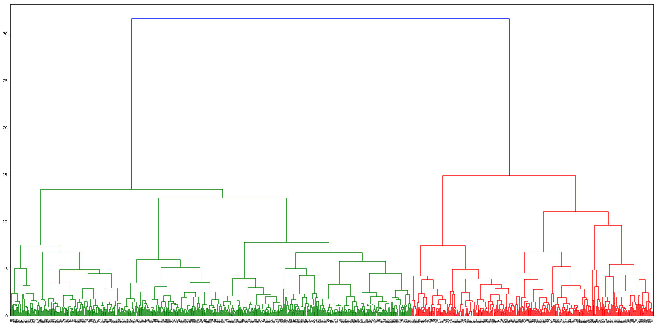
HierarchIal MODEL ..SCIPY LIBRARY
Euclidean+WARD +norm_X
Euclidean+WARD +X

Slide 17
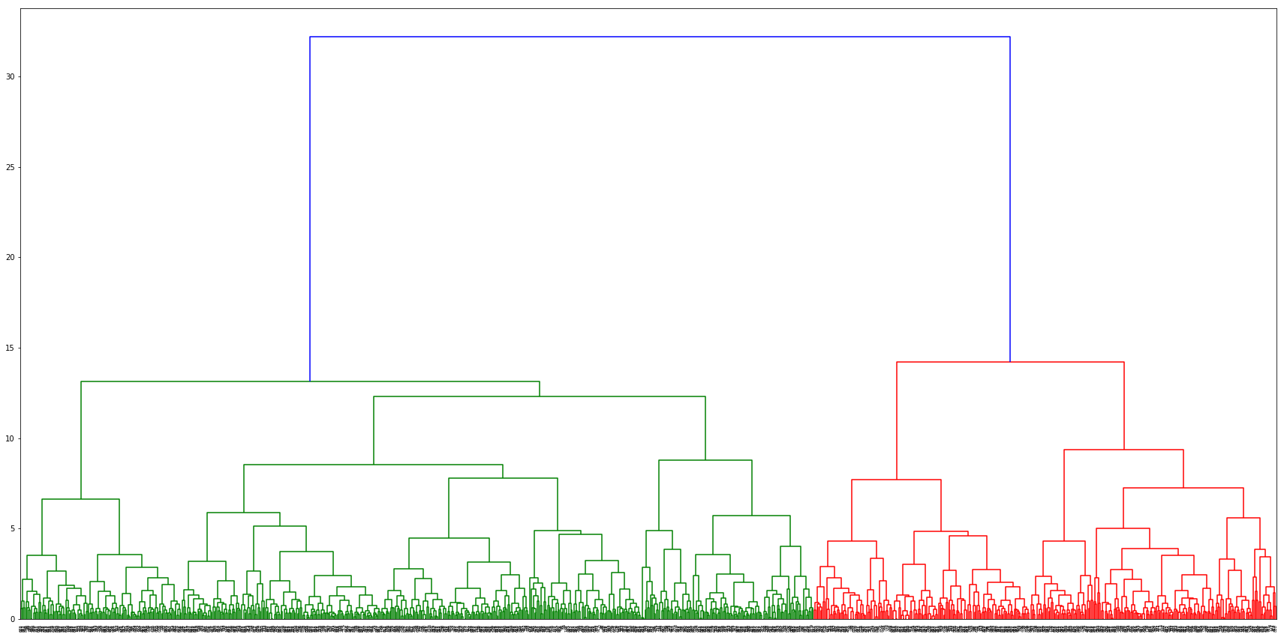
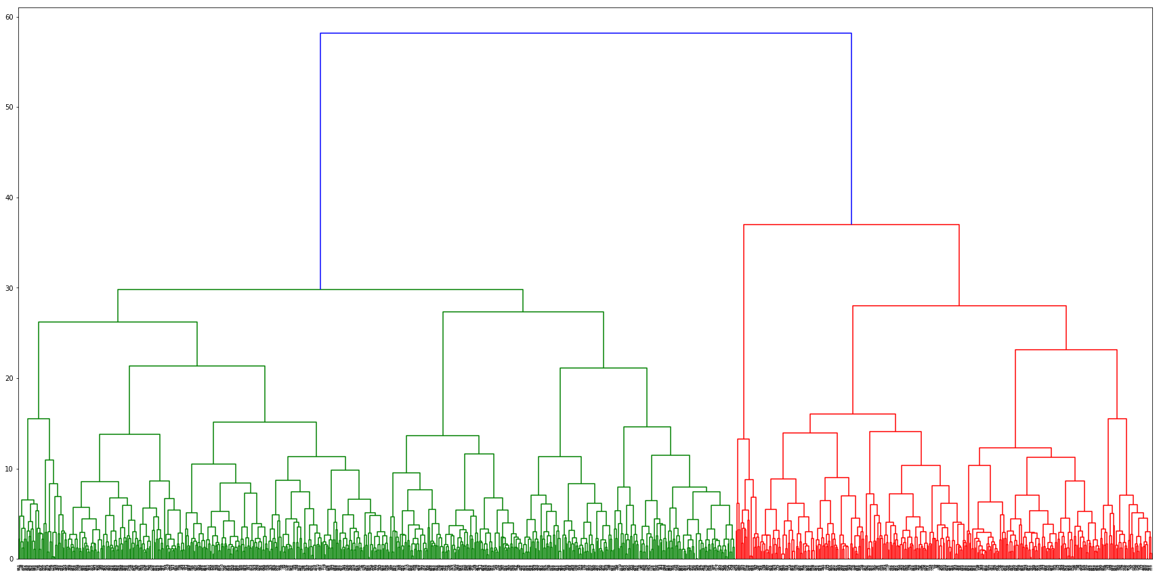
HierarchIal MODEL ..SCIPY LIBRARY
Euclidean+WARD +pca_X
Euclidean+WARD +rescaled_X

Slide 18
At Eucledian dist of 2.33 & Norm_X
max_d=2.33
cl=fcluster(f1,max_d,criterion="maxclust")
set(fcluster(f1,max_d,criterion="maxclust"))
We get a 2 cluster Solution

Slide 19
`
HierarchIal MODEL ..Sklearn LIBRARY
3 cluster +Euclidean+Ward
Silhouette_Avg=0.145
2 cluster +Euclidean+Ward
Silhouette_Avg=0.28
2 cluster +cosine+Complete
Silhouette_Avg=0.077
2 cluster option gives the best silhouette score
Note : X is normalized

Slide 20
Kmeans -2 cluster & 3 cluster
2 CLUSTERs
2-3-4 CLUSTERs

Slide 21
MODEL SELECTION and conclusion
Overall Kmeans is the best model with highest Silhouette score
Dataset not amenable to more than 2 clusters.
Silhouette Score is <0.8 for KMeans (2 cluster with PCA) therefore we need to look at the option of Fuzzy logic (soft clusters )

